Slide 1
Day 1 Agenda
DAY
1
Introduction to Formality
1
2
Getting Started with Formality
3
Basic Formality Flow
4
Reading Designs
5
Matching
6
Verification

Slide 2
Unit Objectives
After completing this unit, you should be able to:
Invoke Formality – both shell and GUI
Launch GUI from within the shell
Modify setup files
Create log files
List Formality commands and variables
Display syntax for commands and variables
Display detailed explanations of commands
and variables
2

Slide 3
Unit Objectives
This is an Instructor Guide page!
Switch to "Notes" view.
Notes:
Unit Objectives
Key Message/Points: Your Goal: Make the student independent as quickly as possible by covering the help system and other ways to get information. We’ll also go over the features in the GUI that control the display (and filtering) of information.
Key Message: You won’t be able to remember all that you learn in the next two days. So, let’s show you some quick and easy ways to find implementation-level detail.
Technical Explanation:
Questions:
Slide Transition:
Instructional Comments:
References/Additional Information:

Slide 4
Invoking Formality: fm_shell
To invoke the Formality shell type fm_shell:
<3> % fm_shell
Formality (R)
Version X-2005.09 – Aug 10, 2005
Copyright (c) 1988-2005 by Synopsys, Inc.
ALL RIGHTS RESERVED
This program is proprietary and confidential information of Synopsys, Inc. and may be used and disclosed only as authorized in a license agreement controlling such use and disclosure.
Loading db file '/sw/formality/X-2005.09/libraries/syn/gtech.db’
fm_shell (setup)>
Redirect output to a file
<4> % fm_shell | tee data.log
3

Slide 5
Invoking Formality: fm_shell
This is an Instructor Guide page!
Switch to "Notes" view.
Notes:
Invoking Formality: shell and GUI
Key Message/Points: bring up the shell with fm_shell
Formality records everything you type, but if you want a record of responses, you need the UNIX tee command.
Technical Explanation:
Questions:
Slide Transition:
Instructional Comments:
References/Additional Information:

Slide 6
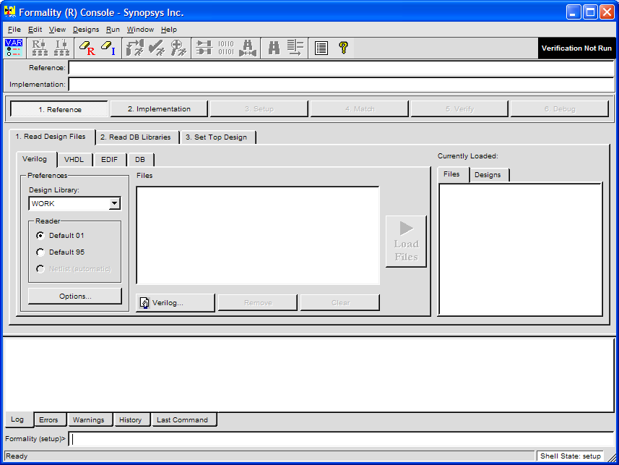
Invoking Formality: GUI
To invoke the Formality GUI, type formality:
<2> % formality
<2> % fm_shell –gui
4

Slide 7
Invoking Formality: GUI
This is an Instructor Guide page!
Switch to "Notes" view.
Notes:
Invoking Formality: GUI and shell
Key Message/Points: How do I invoke the GUI?
Encourage students to work with the GUI (at least to start with) – it really walks them through the flow. However, most power users will work with scripts and only bring up the GUI for debug purposes.
May also redirect output of the formality command.
Technical Explanation:
Questions:
Slide Transition:
You can also launch the GUI from within fm_shell …
Instructional Comments:
References/Additional Information:

Slide 8
Launching GUI from within fm_shell
To launch the GUI type start_gui:
<3> % fm_shell
Formality (R)
Version 2005.09 – Aug 10, 2005
Copyright (c) 1988-2005 by Synopsys, Inc.
ALL RIGHTS RESERVED
This program is proprietary and confidential information of Synopsys, Inc. and may be used and disclosed only as authorized in a license agreement controlling such use and disclosure.
Loading db file '/sw/formality/X-2005.09/libraries/syn/gtech.db’
fm_shell (setup)>start_gui
5

Slide 9
.synopsys_fm.setup File
When Formality is invoked, it reads a file called .synopsys_fm.setup, containing commands such as:
  set search_path “. ./lib ./netlists ./rtl”
  history keep 200
  alias h history
It is read from each of the following 3 locations:
  1st. <formality_root>/admin/setup/.synopsys_fm.setup
  2nd. Your home directory
  3rd. Current working directory
The effect of the setup files is cumulative:
  The setup files in all 3 locations are read into Formality, in the order shown above
6

Slide 10
.synopsys_fm.setup File
This is an Instructor Guide page!
Switch to "Notes" view.
Notes:
.synopsys_fm.setup File
Key Message/Points: Recommend that they NOT use the setup file in ~user. Keep everything in the project directory; easier to archive everything, easier to tar up everything if you’ll be sharing it or asking for help.
Technical Explanation:
Questions:
Slide Transition:
Instructional Comments:
References/Additional Information:

Slide 11
Formality Command Syntax and Tcl
Formality command syntax is based on Tcl:
  Full support for Tcl constructs such as lists and procedures
  Most Formality commands support Tcl wildcards
fm_shell (verify)> set search_path {. ./rtl}
fm_shell (verify)> read_verilog –r {fifo.v fifo_ctrl.v}
fm_shell (verify)> find_ports clk*
Formality command
Tcl wildcard
Tcl list
7

Slide 12
Formality Command Syntax and Tcl
This is an Instructor Guide page!
Switch to "Notes" view.
Notes:
Formality Command Syntax and Tcl
Key Message/Points: Asterisk matches zero or more characters; question mark matches one.
Technical Explanation:
Questions:
Slide Transition:
Instructional Comments:
References/Additional Information:

Slide 13
Tcl Variables in Formality
Tcl variables are used to set options in Formality
Currently there are over 100 Tcl variables
Fewer than 20 are commonly used
Use printvar to display the value of a Tcl variable
Example:
fm_shell (setup)> printvar
bus_dimension_separator_style = "]["
bus_extraction_style = "%s[%d:%d]"
bus_naming_style = "%s[%d]"
bus_range_separator_style = ":"
diagnosis_pattern_limit = "256"
edifin_ground_cell_name = "logic_0"
...
fm_shell (setup)>
fm_shell (setup)> printvar search*
search_path = ”. ./lib"
8

Slide 14
Tcl Variables in Formality
This is an Instructor Guide page!
Switch to "Notes" view.
Notes:
Tcl Variables in Formality
Key Message/Points: You can customize your session using variables. Many possibilities, but only about 15 are commonly used. Printvar is a key command; not only does it display information and settings; it is a great typing aid when setting those long explicitly-named variables.
Technical Explanation:
Questions:
Slide Transition:
Instructional Comments:
References/Additional Information:

Slide 15
Formality’s Tcl Variables
How to set a Tcl variable:
Many variables can take only predefined values:
fm_shell (setup)> set search_path ”. ./lib ./rtl”
. ./lib ./rtl
fm_shell (setup)>
fm_shell (setup)> printvar search*
search_path = ”. ./lib ./rtl"
fm_shell (setup)> set sh_enable_page_mode true
true
fm_shell (setup)> set sh_enable_page_mode page Error: can't set “sh_enable_page_mode": invalid value: use true or false Use error_info for more info. (CMD-013)
fm_shell (setup)>
9

Slide 16
Formality’s Tcl Variables
Info message displayed when a variable name is spelled incorrectly:
fm_shell (setup)> set sh_enavle_page_mode true
Information: Defining new variable 'sh_enavle_page_mode'. (CMD-041)
true
9

Slide 17
Formality’s Tcl Variables
This is an Instructor Guide page!
Switch to "Notes" view.
Notes:
Formality’s Tcl Variables
Key Message/Points: A list must be enclosed in quotation marks. Error messages are helpful for those variables that require a specific value.
Technical Explanation:
Questions:
Slide Transition:
Instructional Comments:
References/Additional Information:

Slide 18
Getting Brief Help On Commands
From the Formality prompt:
  Type help command_name
  help -verbose command_name
fm_shell (setup)> help report_con*
report_constants # Report user specified constants report_constraint # Reports on the defined constraints report_constraint_type # Reports information about constraint types report_containers # Report containers in session
fm_shell (setup)>
fm_shell (setup)> help -verbose set_user_match
set_user_match # Sets the specified design objects as matched points
[-type type] (Type of objects:
Values: port, net, cell, pin)
objectID1 (First design object of point pair)
objectID2 (Second design object of point pair)
fm_shell (setup)>
10

Slide 19
Getting Brief Help On Commands
This is an Instructor Guide page!
Switch to "Notes" view.
Notes:
Getting Brief Help On Commands
Key Message/Points: Help, especially with a wildcard, shows all matches along with a single-line definition. Once you find the command you want, get skeletal syntax with help –verbose. Most of the time, this is all the information you need.
Technical Explanation:
Questions:
Slide Transition:
Instructional Comments:
References/Additional Information:

Slide 20
Command Editing and Completion
The TCL shell supports powerful command editing and completion capabilities
  set the variable sh_enable_line_editing to true in your .synopsys_fm.setup file
For example, command completion with “Tab”
fm_shell (setup)> read_v
read_verilog read_vhdl
fm_shell (setup)> read_verilog
Hit Tab key
Enter “e” and hit Tab key
11
Notes:
Character in bold are typed by the user.
<Tab> means that the user pressed the “Tab” key.

Slide 21
Getting Detailed Help
To get detailed help on commands, variables and error or warning messages, type man command_name (or tcl_variable_name or msg_id).
fm_shell (setup)> man set_user_match
fm_shell (setup)> man hdlin_interface_only
fm_shell (setup)> read_verilog r400.v
Error: Can't open file r400.v (FM-016)
0
Formality (verify)> man FM-016
Command Reference N. Messages messages
NAME
FM-016 (error) Can't open file %s
DESCRIPTION
The specified file does not exist or cannot be created.
WHAT NEXT
Verify that you specified the correct filename and that
you have permission to open and create files.
12

Slide 22
Getting Detailed Help
This is an Instructor Guide page!
Switch to "Notes" view.
Notes:
Getting Detailed Help
Key Message/Points: For those commands where you want ALL the information you can get, the familiar man command is available. It also works for variables and errors.
Technical Explanation:
Questions:
Slide Transition:
Instructional Comments:
References/Additional Information:

Slide 23
Other Help Sources
Outside of Formality:
  Formality documentation (release notes and user guides) in .pdf format on the web
    http://www.synopsys.com
    SolvNET
    Login to SolvNet
    Documentation and Media->Documentation on the Web
    Choose a document
    Click on the book icon to download it
  SOLV-IT
    http://www.synopsys.com
    SolvNET
    Login to SolvNet
      Enter your “Search SOLV-IT” question or
      Choose from one of the SOLV-IT search choices
    See appendix B for more information on SOLV-IT
13

Slide 24
Other Help Sources
This is an Instructor Guide page!
Switch to "Notes" view.
Notes:
Other Help Sources
Key Message/Points: Starting with 2002.05, documentation must be downloaded from the web – it does not ship in the software tree anymore.
Solvit is a great source for methodologies and ‘how to’s’.
Formality News is helpful; new features; useful in deciding when to upgrade.
Technical Explanation:
Questions:
Slide Transition:
Instructional Comments:
References/Additional Information:

Slide 25
Running Formality Scripts
To execute a tcl script in formality:
<2> % fm_shell –f script.tcl | tee script.log
fm_shell > source script.tcl
Formality GUI: File->Run Script
14

Slide 26
Running formality scripts
This is an Instructor Guide page!
Switch to "Notes" view.
Notes:
Running Formality Scripts
Key Message/Points: Commands put into text files can be sourced and executed in formality.
Can use the transcript to generate a script for the next run.
Technical Explanation:
Questions:
Slide Transition:
Instructional Comments:
References/Additional Information:

Slide 27
Files that Formality Generates
Record of commands issued
  fm_shell_command.log
Logfile of informational messages
  formality.log
Working files
  FM_WORK directory
  fm_shell_command.lck and formality.lck
  Formality automatically deletes all Working files when you exit (gracefully).
15

Slide 28
Files that Formality Generates
This is an Instructor Guide page!
Switch to "Notes" view.
Notes:
Files that Formality Generates
Key Message/Points: Formality does generate some files in your working directory,
Technical Explanation:
Questions:
Slide Transition:
Instructional Comments: It’s a good idea not to exit with Control-C. If you do you will litter your working directory with FM_WORK sub-directories, fm_shell_command.lck and formality.lck. If you do crash out of Formality you can clean up with standard Unix commands.
References/Additional Information:

Slide 29
Summary
The three most important commands for getting help:
  printvar
    Displays the value of a Tcl variable
    Accepts wildcards
  help
    Display brief description of a Formality command
    Accepts wildcards
  man
    Displays detailed info on a Formality command or Tcl variable
    Does not accept wildcards
16

Slide 30
Summary
This is an Instructor Guide page!
Switch to "Notes" view.
Notes:
Summary
Key Message/Points: They’ll mix up commands and variables all the time. Remind them – help is for commands, printvar is for variables. If you try help and get nothing, try printvar; and vice versa.
Technical Explanation:
Questions:
Slide Transition:
Instructional Comments:
References/Additional Information:

Slide 31
Review Questions
1. What command would you use to:
  Invoke the Formality shell?
  Invoke the Formality GUI?
2. Explain the following command:
  % fm_shell | tee data.log
3. When Formality is invoked, what file does it read and from what 3 locations will it read this file?
4. Are Tcl variables used to set options in Formality?
5. How many Tcl variables are there currently?
6. What are the three most important commands for finding help? State at least one function of each.
7. Name at least two other sources for help.
17

Slide 32
Review Questions
This is an Instructor Guide page!
Switch to "Notes" view.
Notes:
Review Questions
Key Message/Points:
Answers:
1. Fm_shell
Formality or fm_shell, then start_gui
2. Piping to tee captures Formality’s responses, as well as your commands
3. .synopsys_fm.setup – in the admin area of the Formality tree, in your user directory, and in your project directory.
4 Yes –
5. Over 100 – but emphasize that only about 10 are commonly used. If you don’t understand the variable don’t mess with it!!!.
6. Help – one-line summaries
Help –verbose – skeletal syntax
Printvar – variable settings
Man – detailed info on commands, variables, and error messages.
7. Online documentation
Solvit
Technical Explanation:
Questions:
Slide Transition:
Instructional Comments:
References/Additional Information:

Slide 33
Lab 2: Getting Started With Formality
Getting to know the Formality environment
GUI/shell
25 minutes
printvar/help/man
source script.tcl
Report
18

Slide 34
Lab 2: Getting Started With Formality
This is an Instructor Guide page!
Switch to "Notes" view.
Notes:
Lab 2: Getting Started With Formality
Key Message/Points: Lead-In
This is an orientation, a get-acquainted with the software lab, and should take about 15 minutes.
Key Message(s)
The purpose of the lab is to give students some early hands-on experience with Formality, and to enable them to start becoming independent by using help and printvar with wildcards, as well as man, to find answers to syntax questions.
It also serves to familiarize them with the GUI and with how to control the display of information using tabs and the View menu.
Lead-Out
In going over the answers, the emphasis should be on HOW they got their answers.
Additional Corroborating Information
The signature_analysis_matching variable is found by clicking the shell icon, then clicking the matching tab.
Doing a man on a Formality error message displays the error message, a description, and a ‘what next’.
Resize the console window to the size of the GUI by pulling down the View menu and unchecking the context pane.
Technical Explanation:
Questions:
Slide Transition:
Instructional Comments:
References/Additional Information:

Slide 35
Command Summary
fm_shell [-gui] | Launch Formality from Unix command line
formality | Launch Formality GUI from Unix command line
start_gui | Launch Formality GUI from Formality shell
printvar | Display current value of a tcl variable
set | Set value of a tcl variable
help [-verbose] | Get brief help on a Formality command
man | Get detailed help on a Formality command, variable or error message.
19

